Slide 1
MODULE-5
STRUCTURES AND FILES
C PROGRAMMING (INTEGRATED)- 22CSE14

Slide 2
C Data Types:
Primary data types
Derived
Types
Derived data types
Function
Type
Array Type
Pointer
Type
Structure
Type
Union Type
Array – Collection of one or more related variables of similar data type grouped
under a single name
Structure – Collection of one or more related variables of different
data types, grouped under a single name
Union type –is Derived data types and Collection of one or more related variables of
different data types, grouped under a single name
Note: Array is used to represent a group of data items that belongs to same data-type, such as int or float. However, if we want to represent a collection of data items of different data-types using a single name, then we cannot use an array. For that C supports constructed data type known as structure.
3

Slide 3
Definition of Structure
Structure is a collection of elements of same or different data types under a single name.

Slide 4
Structure Definition:
Syntax:
struct tagName
{
datatype member1;
datatype member2;
------------
------------
datatype membern;
} ;
Example :
struct employee
{
char name[20];
float salary;
int empno;
};
tagname
members

Slide 5
Declaring Structure Variables:
A structure variable declaration is similar to the declaration of variables of any other data types. It includes the following elements:
The keyword struct.
The structure tag name.
List of variable names separated by commas.
A terminating semicolon.
Syntax: struct tagName variable1,variable2;
Eg: struct employee emp1,emp2;

Slide 6
Another way of structure variable declaration
It is also allowed to combine both the structure definition and variables declaration in one statement.
The declaration
struct book_bank
{
char title[20];
char author[15];
int pages;
float price;
} book1, book2, book3;
is valid. The use of tag name is optional here.

Slide 7
Structure Initialization:
Assigning the values to the structure member fields is known as structure initialization.
Syntax:
struct tagName variable = {value1,value2,…valuen};
Eg:
struct employee emp1 = { “Raj”,1000,1};

Slide 8
The complete structure definition, declaration and initialization of employee is as shown below:
Structure Definition :
struct employee
{
char name[20];
float salary;
int empno;
};
Structure Declaration
struct employee emp1,emp2;
Structure Initialization :
struct employee emp1 = { “ Raj”,1000,1};
struct employee emp2 = { “Taj”,2000,2};

Slide 9
Accessing Members of Structures
The member of structure is identified and accessed using the dot operator(.)
The link between a member and a variable is established using the member operator ‘.’ which is also known as ‘dot operator’ or ‘period operator’.
Syntax is :
struct_variable.membername;

Slide 10
Example : Consider the structure definition and initialization as shown below:
struct employee
{
char name[10];
float salary ;
int empno;
};
struct employee e = { “Raj”,1000,1};
e.name can access the string “Raj”
e.salary can access the value 1000
e.empno can access the value of 1
Structure definition
Structure initialization

Slide 11
Displaying the various members of Structures
printf(“%s”,e.name); //prints the name of the employee
printf(“%f”,e.salary); // prints the salary
printf(“%d”,e.empno); //prints the employee number

Slide 12
Reading the values for various members of structures
scanf(“%s”, e.name); //reads the employee name
scanf(“%f”, &e.salary); // reads the salary of employee
scanf(“%d”, &e.empno); // reads the employee id

Slide 13
Write a program to read employee number, name, salary and print the details.
#include<stdio.h>
struct employee
{
char name[20];
float salary;
int empno;
};
void main()
{
struct employee e;
printf("Enter name, number and salary of employee\n");
scanf("%s%d%f", e.name, &e.empno, &e.salary); //reading details
printf("Entered name number and salary of employee is\n");
printf("%s \t%d \t%f", e.name, e.empno, e.salary); // printing details
}
Structure definition
Structure declaration with variable e

Slide 14
Array inside structure
#include<stdio.h>
struct student
{
char name[20];
int usn;
int marks[3], total;
};
void main()
{
struct student s;
int i,n;
printf("Enter the usn and name\n");
scanf("%d%s",&s.usn,s.name);
Array of marks as a data member

Slide 15
printf("Enter marks in 3 subjects\n");
for(i=0;i<3;i++)
{
scanf("%d",&s.marks[i]);
s.total = s.total + s.marks[i];
}
printf("Student with usn %d and name %s has total marks=%d\n",s.usn,s.name,s.total);
}
Reading three marks and calculating its total

Slide 16
Array of Structures
It is a collection of structure variables
Syntax:
struct tag_namestructure_variable[size];
To store the information of 10 students consisting of name and usn.
struct student
{
char name[30];
int roll_no;
float marks;
};
To store the information of 10 students the structure variable has to be declared as follows:
struct Student s[10];
s is an array consisting of 10 memory location. Each memory location is of type struct student hence 10 student information can be stored.
To access member of a structure below symbol is used:
structure_variable[subscript].members

Slide 17
C program to read and print n employee details
#include<stdio.h>
struct employee
{
char name[20];
float salary;
int empno;
};
void main()
{
struct employee e[10];
int n,i;
printf("Enter no.of employees\n");
scanf("%d",&n);
for(i=0;i<n;i++)
{
printf("Enter details of employee %d \n",i+1);
printf("Enter name, salary and employee_number\n");
scanf("%s%f%d",e[i].name,&e[i].salary,&e[i].empno);
}
Array of structures to store
Multiple ( employee details
Reading n employees details using array of structures

Slide 18
for(i=0;i<n;i++)
{
printf("\nDetails of employee %d \n",i+1);
printf("Entered name salary and employee_number is:-\n");
printf("%s\t%f\t%d",e[i].name, e[i].salary,e[i].empno);
}
}

Slide 19
Output
Enter no.of employees
2
Enter details of employee 1
Enter name, salary and employee_number
Raj
12000
15
Enter details of employee 2
Enter name, salary and employee_number
Thejas
10000
18
Details of employee 1
Entered name salary and employee_number is:-
Raj 12000 15
Details of employee 2
Entered name salary and employee_number is:-
Thejas 10000 18

Slide 20
Rules for Initializing Structures
We cannot initialize individual members inside the structure template.
The order of values enclosed in braces must match the order of members in the structure definition.
It is permitted to have a partial initialization. We can initialize only the first few members and leave the remaining blank. The uninitialized members should be only at the end of the list.
The uninitialized members will be assigned default values as follows:
  Zero for integer and floating point numbers.
  ‘\0’ for characters and strings.

Slide 21
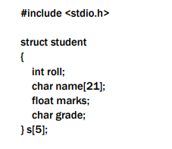
Write a C program to maintain a record of n students details using an array of structures with four fields-Roll number, name, marks and grade. Calculate the grade according to the following conditions. Marks grade >=80 A ,>=60 B,>=50 C,>=40 D.

Slide 22
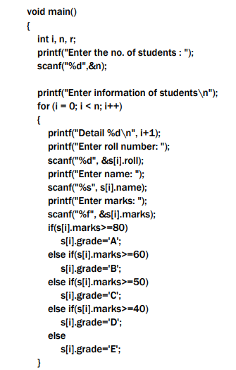

Slide 23
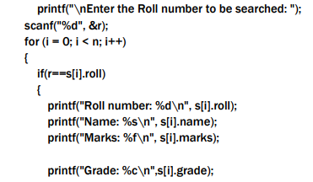
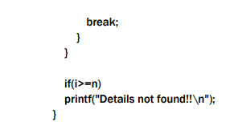

Slide 24
Write a program to read employee number, name, salary and print the details if salary is greater then Rs.5000.
#include<stdio.h>
struct employee
{
char name[20];
float salary;
int empno;
};
void main()
{
struct employee e[10];
int n,i;
printf("Enter no.of employees\n");
scanf("%d",&n);
for(i=0;i<n;i++)
{
printf("Enter details of employee %d \n",i+1);

Slide 25
printf("Enter name, salary and number of employee\n");
scanf("%s%f%d",e[i].name,&e[i].salary,&e[i].empno);
}
printf("Details of employees whose salary is greater than 5000 are\n");
for(i=0;i<n;i++)
{
if(e[i].salary>5000)
{
printf("%s %f %d\n",e[i].name,e[i].salary,e[i].empno);
}
}
}
Each employee salary is checked

Slide 26
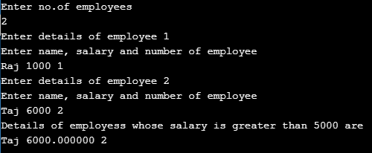
Output

Slide 27
Structures using typedef
The structure defined using the keyword typedef is called type defined structure.

Slide 28
Syntax:
typedef struct
{
  datatype member1;
  datatype member2;
  ----------------------
} tagName ;
Example :
typedef struct
{
  char name[20];
  float salary;
  int empno;
} employee;

Slide 29
Example program using typedef in structures:
#include<stdio.h>
typedef struct
{
  char name[20];
  float salary;
  int empno;
} employee;
void main()
{
  employee e={"Raj",1000,101};
  printf("Employee name salary and number is\n");
  printf("%s %f %d",e.name,e.salary,e.empno);
}

Slide 30
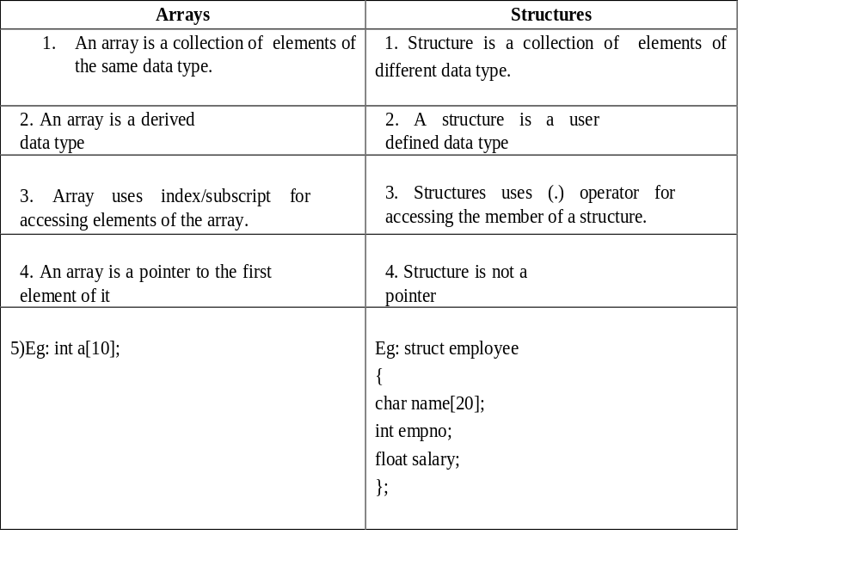
Difference between Arrays and Structures

Slide 31
Write a C program to compare two student structures with data members name and marks and print if students are same or different
#include<stdio.h>
#include<string.h>
struct student
{
char name[20];
int marks;
};
Void main()
{
struct student s1,s2;
int result;
printf (“enter student1 name and marks”);
scanf(“%s %d”, s1.name,s1.marks);
printf (“enter student2 name and marks”);
scanf(“%s %d”, s2.name,s2.marks);

Slide 32
result=strcmp(s1.name,s2.name);
if(result==0 && s1.marks==s2.marks)
printf("Students are same");
else
printf("Students are different");
}

Slide 33
Program to add two distances in the inch-feet system using structures
#include <stdio.h>
struct Distance
{
int feet;
float inch;
} d1, d2, result;
int main()
{
// take first distance input
printf("Enter 1st distance\n");
printf("Enter feet: ");
scanf("%d", &d1.feet);
printf("Enter inch: ");
scanf("%f", &d1.inch);

Slide 34
// take second distance input
printf("\nEnter 2nd distance\n");
printf("Enter feet: ");
scanf("%d", &d2.feet);
printf("Enter inch: ");
scanf("%f", &d2.inch);
// adding distances
result.feet = d1.feet + d2.feet;
result.inch = d1.inch + d2.inch;
// convert inches to feet if greater than 12
while (result.inch >= 12.0)
{
result.inch = result.inch - 12.0;
++result.feet;
}
printf("\nSum of distances = %d\'-%.1f\"", result.feet, result.inch);
return 0;
}

Slide 35
Files

Slide 36
A file is a place on the disk where a group of related data is stored. Like most other languages, C supports a number of functions that have the ability to perform basic file operations, which include:
naming a file,
opening a file,
reading data from a file,
writing data to a file, and
closing a file

Slide 37
Function Name | Operation
fopen() | Creates a new file/Opens an existing file for use.
fclose() | Closes a file which has been opened for use.
getc() | Reads a character from a file.
putc() | Writes a character to a file.
fprintf() | Writes a set of data values to a file.
fscanf() | Reads a set of data values to a file.
getw() | Reads an integer from file.
putw() | Writes an integer from file.
fseek() | Sets the position to a desired a point in the file.
ftell() | Gives the correct position in the file.
rewind() | Sets the position to the beginning of the file.

Slide 38
DEFINING AND OPENING A FILE
If we want to store data in a file in the secondary memory, we must specify certain things about the file, to the operating system. They include the following:
  Filename
  Data structure
  Purpose
Filename is a string of characters that make up a valid filename for the operating system. It may contain two parts, a primary name and an optional period with the extension
Data structure of a file is defined as FILE in the library of standard I/O function definitions

Slide 39
general format for declaring and opening a file:
FILE *fp;
fp = fopen(“filename”, “mode”);
The first statement declares the variable fp as a “pointer to the data type FILE”.
The second statement opens the file filename and assigns an identifier to the FILE type pointer fp. It also specifies the purpose of opening this file. The mode does this job.
Modes
  r open the file for reading only.
  w open the file for writing only.
  a open the file for appending (or adding) data to it.
  Many recent compilers include additional modes of operation. They include:
  r+ The existing file is opened to the beginning for both reading and writing.
  w+ Same as w except both for reading and writing.
  a+ Same as a except both for reading and writing.
FILE *p1, *p2;
p1 = fopen(“CPU” , “r”);
p2 = fopen(“Data” , “w”);

Slide 40
CLOSING A FILE
A file must be closed as soon as all operations on it have been completed. This ensures that all outstanding information associated with the file is flushed out from the buffers and all links to the file are broken
fclose(file_pointer);
EXAMPLE:-
FILE *p1, *p2;
p1 = fopen(“INPUT”, “w”);
p2 = fopen(“OUTPUT”, “r”);
…….
…….
fclose(p1);
fclose(p2);

Slide 41
INPUT/OUTPUT OPERATIONS ON FILES
The getc and putc Functions
Assume that a file is opened with mode w and fi le pointer fp1. Then, the statement
putc(c, fp1);
writes the character contained in the character variable c to the file associated with FILE pointer fp1.
Similarly, getc is used to read a character from a fi le that has been opened in read mode. For example, the statement
c = getc(fp2);
would read a character from the fi le whose fi le pointer is fp2.

Slide 42
The getw and putw Functions
The getw and putw are integer-oriented functions. They are used to read and write integer values. These functions would be useful when we deal with only integer data.
The general forms of getw and putw are as follows:
putw(integer, fp);
getw( fp);

Slide 43
The fprintf and fscanf Functions
The first argument of these functions is a file pointer which specifies the file to be used. The general form of fprintf is
fprintf(fp, “control string”, list);
where fp is a file pointer associated with a file that has been opened for writing.
The control string contains output specifications for the items in the list.
The list may include variables, constants and strings.
Example:
fprintf(f1, “%s %d %f”, name, age, 7.5);

Slide 44
The general format of fscanf is
fscanf(fp, “control string”, list);
This statement would cause the reading of the items in the list from the file specified by fp, according to the specifications contained in the control string. Example:
fscanf(f2, “%s %d”, item, &quantity);

Slide 45
ERROR HANDLING DURING I/O OPERATIONS
It is possible that an error may occur during I/O operations on a fi le. Typical error situations include the following:
1. Trying to read beyond the end-of-file mark.
2. Device overflow.
3. Trying to use a fi le that has not been opened.
4. Trying to perform an operation on a fi le, when the fi le is opened for another type of operation.
5. Opening a fi le with an invalid filename.
6. Attempting to write to a write-protected file

Slide 46
we have two status-inquiry library functions; feof and ferror that can help us detect I/O errors in the fi les.
The feof function can be used to test for an end of file condition. It takes a FILE pointer as its only argument and returns a nonzero integer value if all of the data from the specified file has been read, and returns zero otherwise
if(feof(fp))
printf(“End of data.\n”);
would display the message “End of data.” on reaching the end of file condition.

Slide 47
The ferror function reports the status of the file indicated. It also takes a FILE pointer as its argument and returns a nonzero integer if an error has been detected up to that point, during processing. It returns zero otherwise. The statement
if(ferror(fp) != 0)
printf(“An error has occurred.\n”);
would print the error message, if the reading is not successful.

Slide 48
If the file cannot be opened for some reason, then the function returns a NULL pointer. This facility can be used to test whether a file has been opened or not. Example:
if(fp == NULL)
printf(“File could not be opened.\n”);

Slide 49
Write a C program to count the number of lines, words and characters in a given text file
#include <stdio.h>
#include <stdlib.h>
int main()
{
FILE * file;
char path[100];
char ch;
int characters, words, lines;
printf("Enter source file path: ");
scanf("%s", path);
file = fopen(path, "r");
if (file == NULL)
{
printf("\nUnable to open file.\n");
printf("Please check if file exists and you have read privilege.\n");
exit(EXIT_FAILURE);
}

Slide 50
characters = words = lines = 0;
while ((ch = fgetc(file)) != EOF)
{
characters++;
if (ch == '\n' || ch == '\0’)
lines++;
if (ch == ' ' || ch == '\t' || ch == '\n' || ch == '\0’)
words++;
}

Slide 51
printf("\n");
printf("Total characters = %d\n", characters);
printf("Total words = %d\n", words);
printf("Total lines = %d\n", lines);
fclose(file);
return 0;
}

Slide 52
Example programs
Define a structure named date containing three integer members day, month, and year. Create two structure variables and initialize them with suitable values and print them in the format dd/mm/yyyy.

Slide 53
Program to find sum of all the elements of an array using pointers.
#include<stdio.h>
main()
{
int i, a[10], n, sum=0,*p;
printf(“enter the size of the array \n”);
scanf(“%d”, &n);
printf("Enter the elements into the array: ");
for(i=0;i<n;i++)
scanf("%d ",&a[i]);

Slide 54
p=a;
for(i=0;i<n;i++)
{
sum=sum+*p;
p++;
}
printf("Sum = %d ",sum);
}

Slide 55
Solve
int x = 10, y = 10;
int *p1 = &x, *p2 = &y;
What is the value of each of the following expressions?
(*p1) ++ ;
– – (*p2) ;
*p1 + (*p2) – – ;
+ + (*p2) – *p1 ;

